Slide 1



Analysis of Algorithms
Presentation for use with the textbook Data Structures and Algorithms in Java, 6th edition, by M. T. Goodrich, R. Tamassia, and M. H. Goldwasser, Wiley, 2014
Input
Algorithm
Output

Slide 2
Seven Important Functions
4.2

Slide 3
Seven Important Functions
Seven functions that often appear in algorithm analysis:
Constant ≈ 1
Logarithmic ≈ log n
Linear ≈ n
N-Log-N ≈ n log n
Quadratic ≈ n²
Cubic ≈ n³
Exponential ≈ 2^{n}
In a log-log chart, the slope of the line corresponds to the growth rate

Slide 4
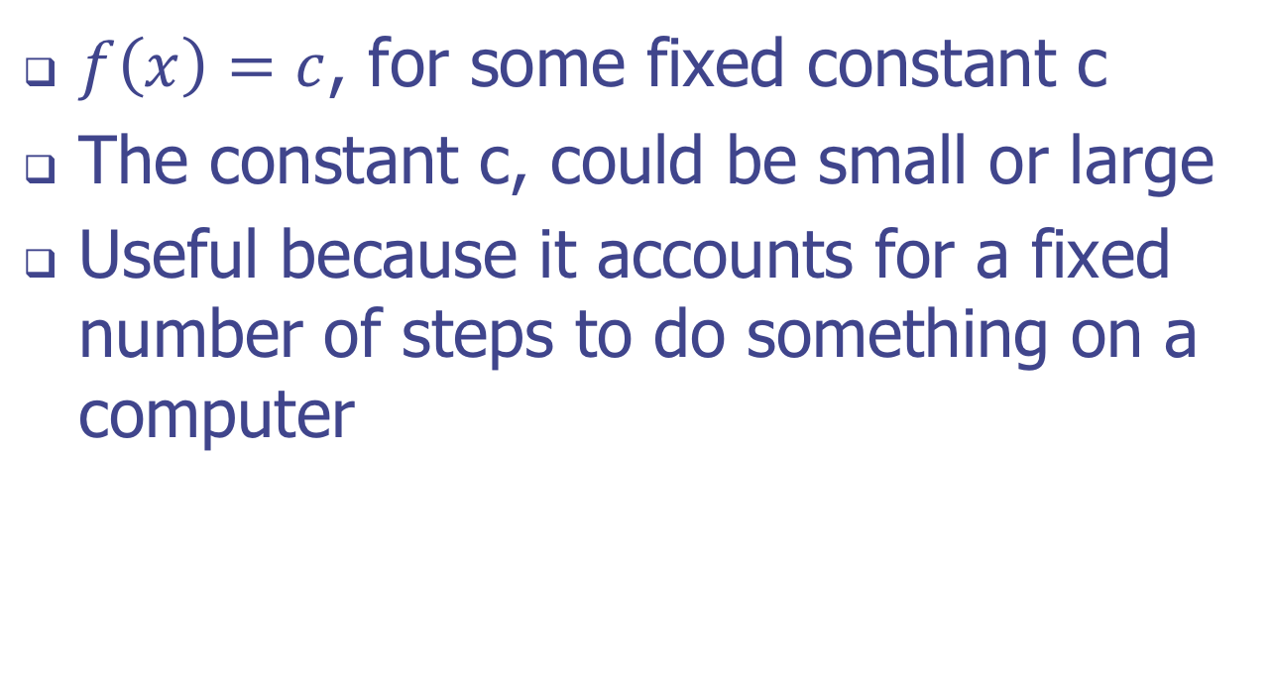
The Constant Function
$f\left(x\right)=c$, for some fixed constant c
The constant c, could be small or large
Useful because it accounts for a fixed number of steps to do something on a computer

Slide 5
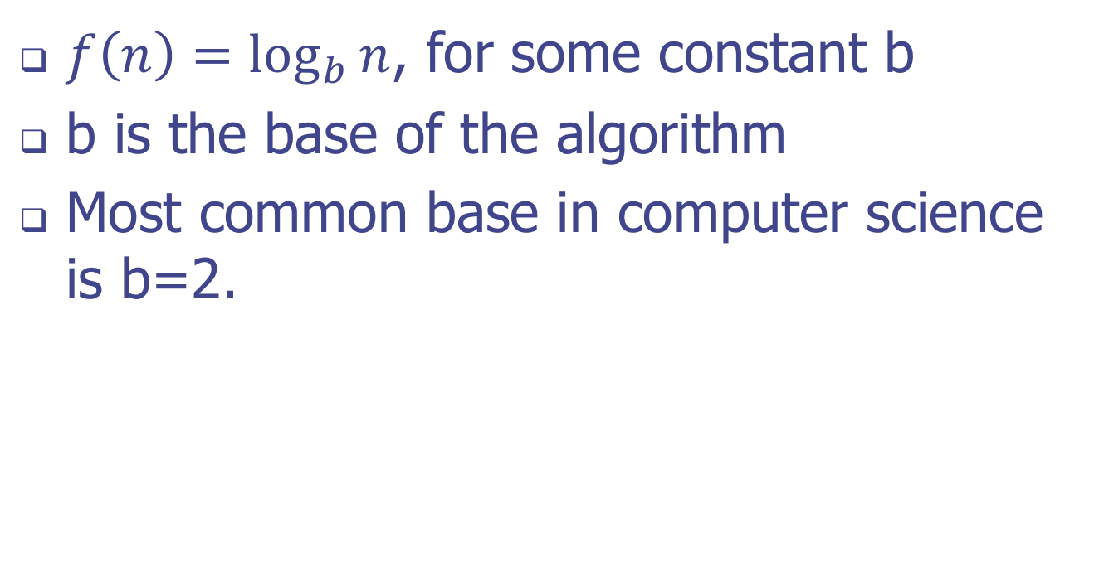
The Logarithm Function
$f\left(n\right)=\log_{b}{n}$, for some constant b
b is the base of the algorithm
Most common base in computer science is b=2.

Slide 6

The Linear Function
$f\left(n\right)=n$
Anything that the algorithm does is directly proportional to the input size

Slide 7
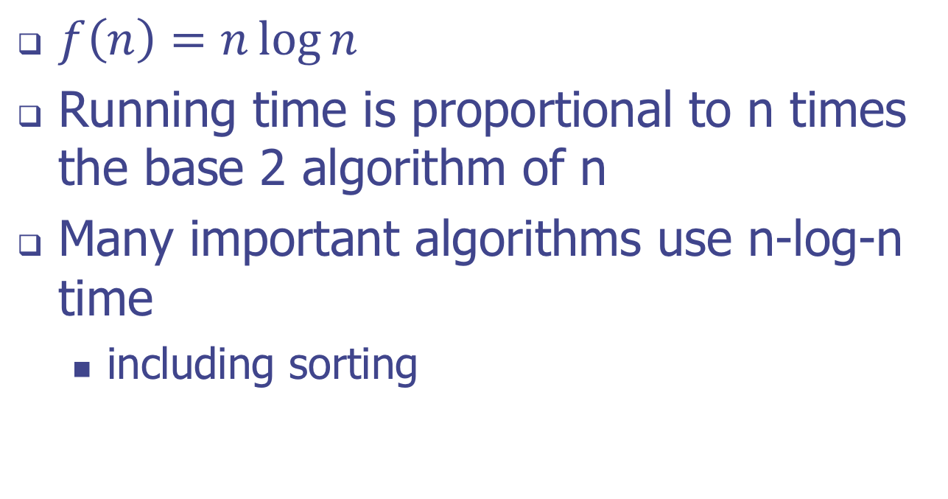
The N-log-N Function
$f\left(n\right)=n\log{n}$
Running time is proportional to n times the base 2 algorithm of n
Many important algorithms use n-log-n time
including sorting

Slide 8
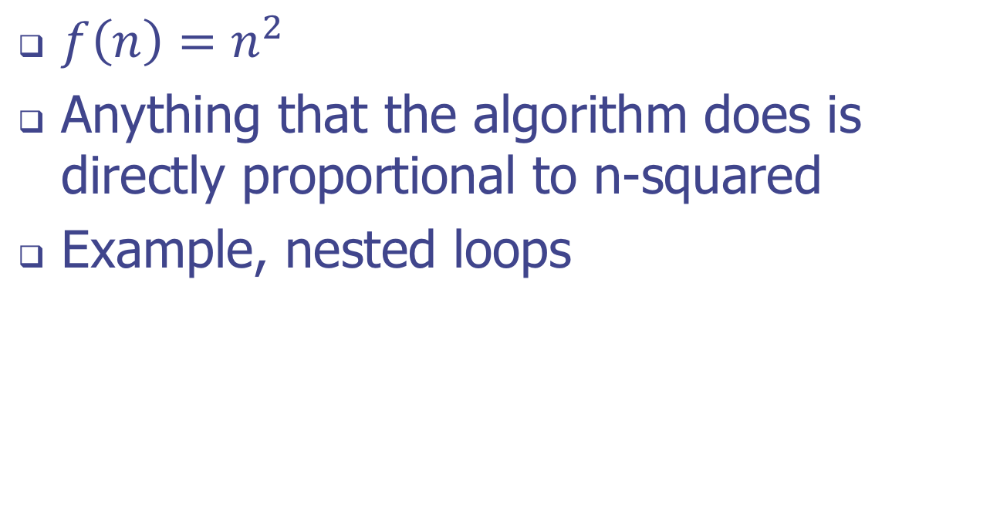
The Quadratic Function
$f\left(n\right)=n^{2}$
Anything that the algorithm does is directly proportional to n-squared
Example, nested loops

Slide 9
Nested Loops and the Quadratic Function
/** Returns the sum of the prefix sums of given array. */
public static int example3(int[] arr) {
int n = arr.length, total = 0;
for (int j=0; j < n; j++) // loop from 0 to n-1
for (int k=0; k <= j; k++) // loop from 0 to j
total += arr[j];
return total;
}
Carl Gauss

Slide 10

Quadratic Function Costs
Avoid a quadratic algorithm if you can!
If you have cost n for each of n inputs, it is quadratic; costs are $n^{2}$.
Squared!

Slide 11
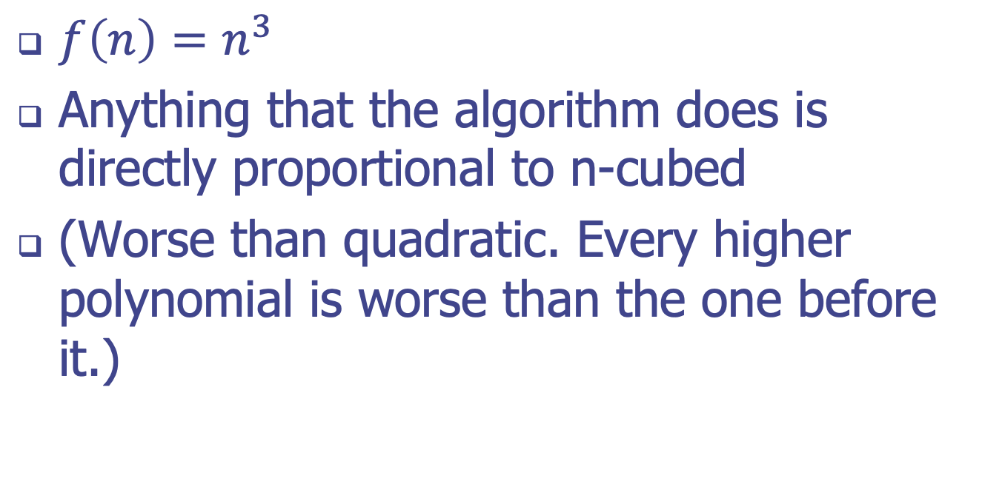
The Cubic Function and Other Polynomials
$f\left(n\right)=n^{3}$
Anything that the algorithm does is directly proportional to n-cubed
(Worse than quadratic. Every higher polynomial is worse than the one before it.)

Slide 12
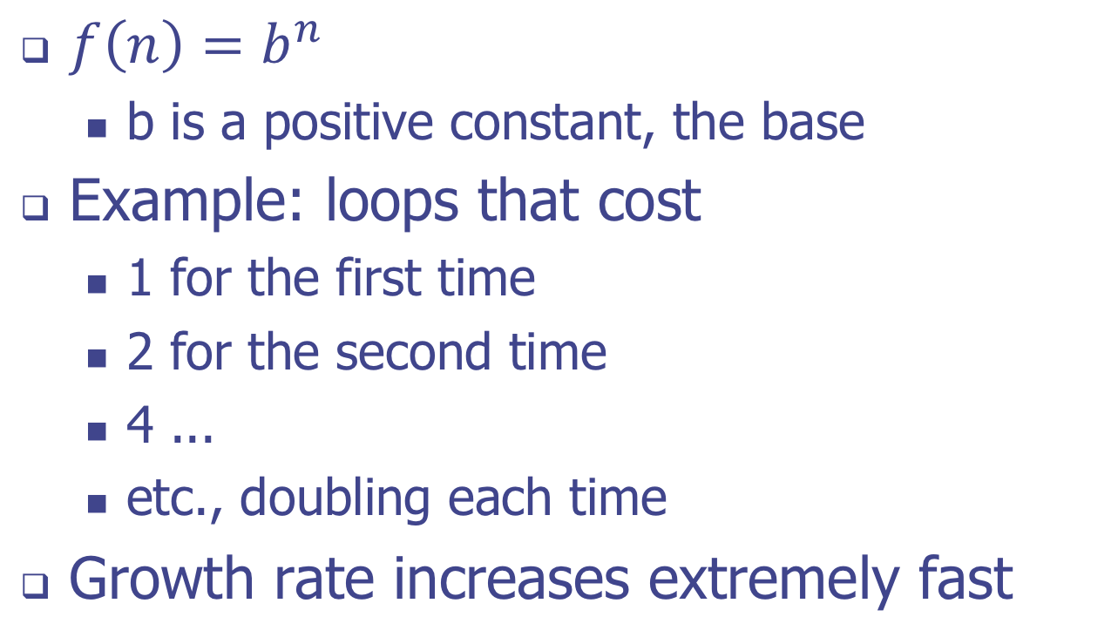
The Exponential Function
$f\left(n\right)=b^{n}$
b is a positive constant, the base
Example: loops that cost
1 for the first time
2 for the second time
4 ...
etc., doubling each time
Growth rate increases extremely fast

Slide 13
Estimating Running Time
4.2.X

Slide 14
Primitive Operations
Basic computations performed by an algorithm
Identifiable in pseudocode
Largely independent from the programming language
Exact definition not important (we will see why later)
Assumed to take a constant amount of time in the RAM model
Examples:
Evaluating an expression
Assigning a value to a variable
Indexing into an array
Calling a method
Returning from a method

Slide 15
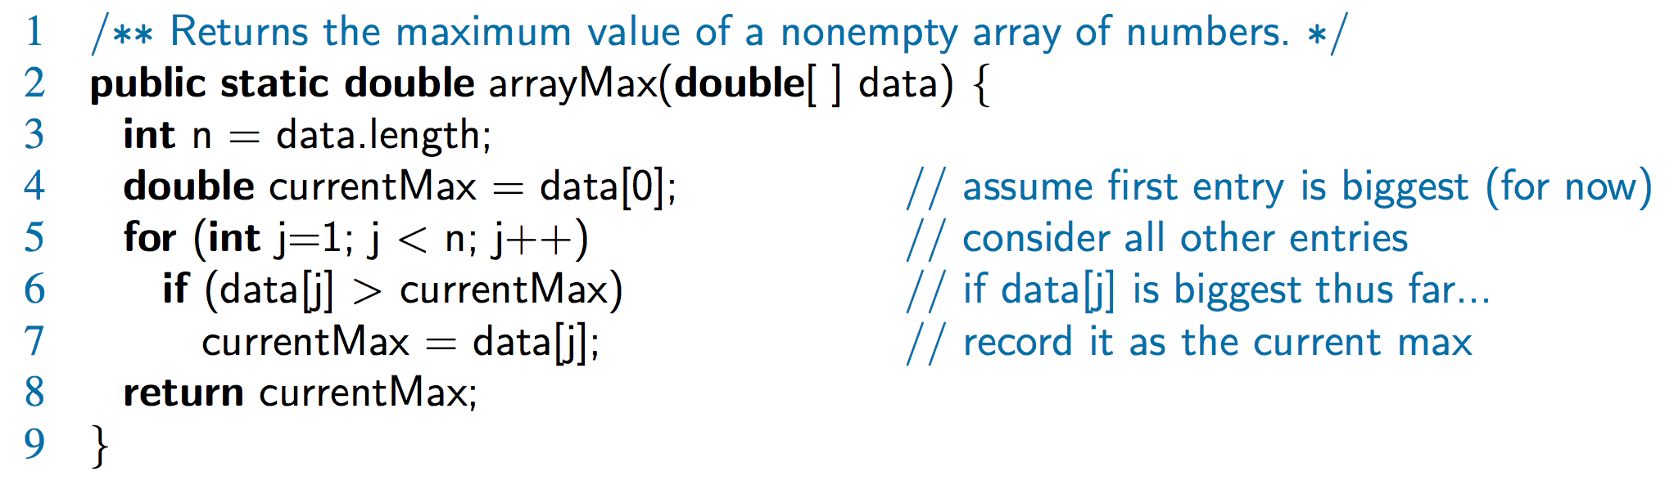
Counting Primitive Operations
By inspecting the pseudocode, we can determine the maximum number of primitive operations executed by an algorithm, as a function of the input size
Step 3: 2 ops, 4: 2 ops, 5: 2n ops, 6: 2n ops, 7: 0 to n ops, 8: 1 op

